Slide 1
Public Library Management System
Course: CST8219 – C++ Programming
Team: Kavya Vasani, Chaitanya patel, Harpreet Singh, Nibir NANDI dibbo, Vasu patel
Instructor: Surbhi bahri
Date: 31st March 2026

Slide 2
Problem Statement
Problem: Manual systems are slow and error-prone
Problem: Difficult to manage items and patrons
Motivation:Need efficient and organized digital system

Slide 3
System Overview
Manage items and patrons
Issue/return items
Search and filter
Analytics
Features

Slide 4

System Architecture
LibraryManager (Core logic)
LibraryItem & Patron
Loan System
DataManager
GUI & Analytics

Slide 5
Software Design
Main Classes:
Relationships
LibraryItem
Patron
Loan (Abstract)
LibraryManager
Loan -> inheritance
Manager -> controls all

Slide 6
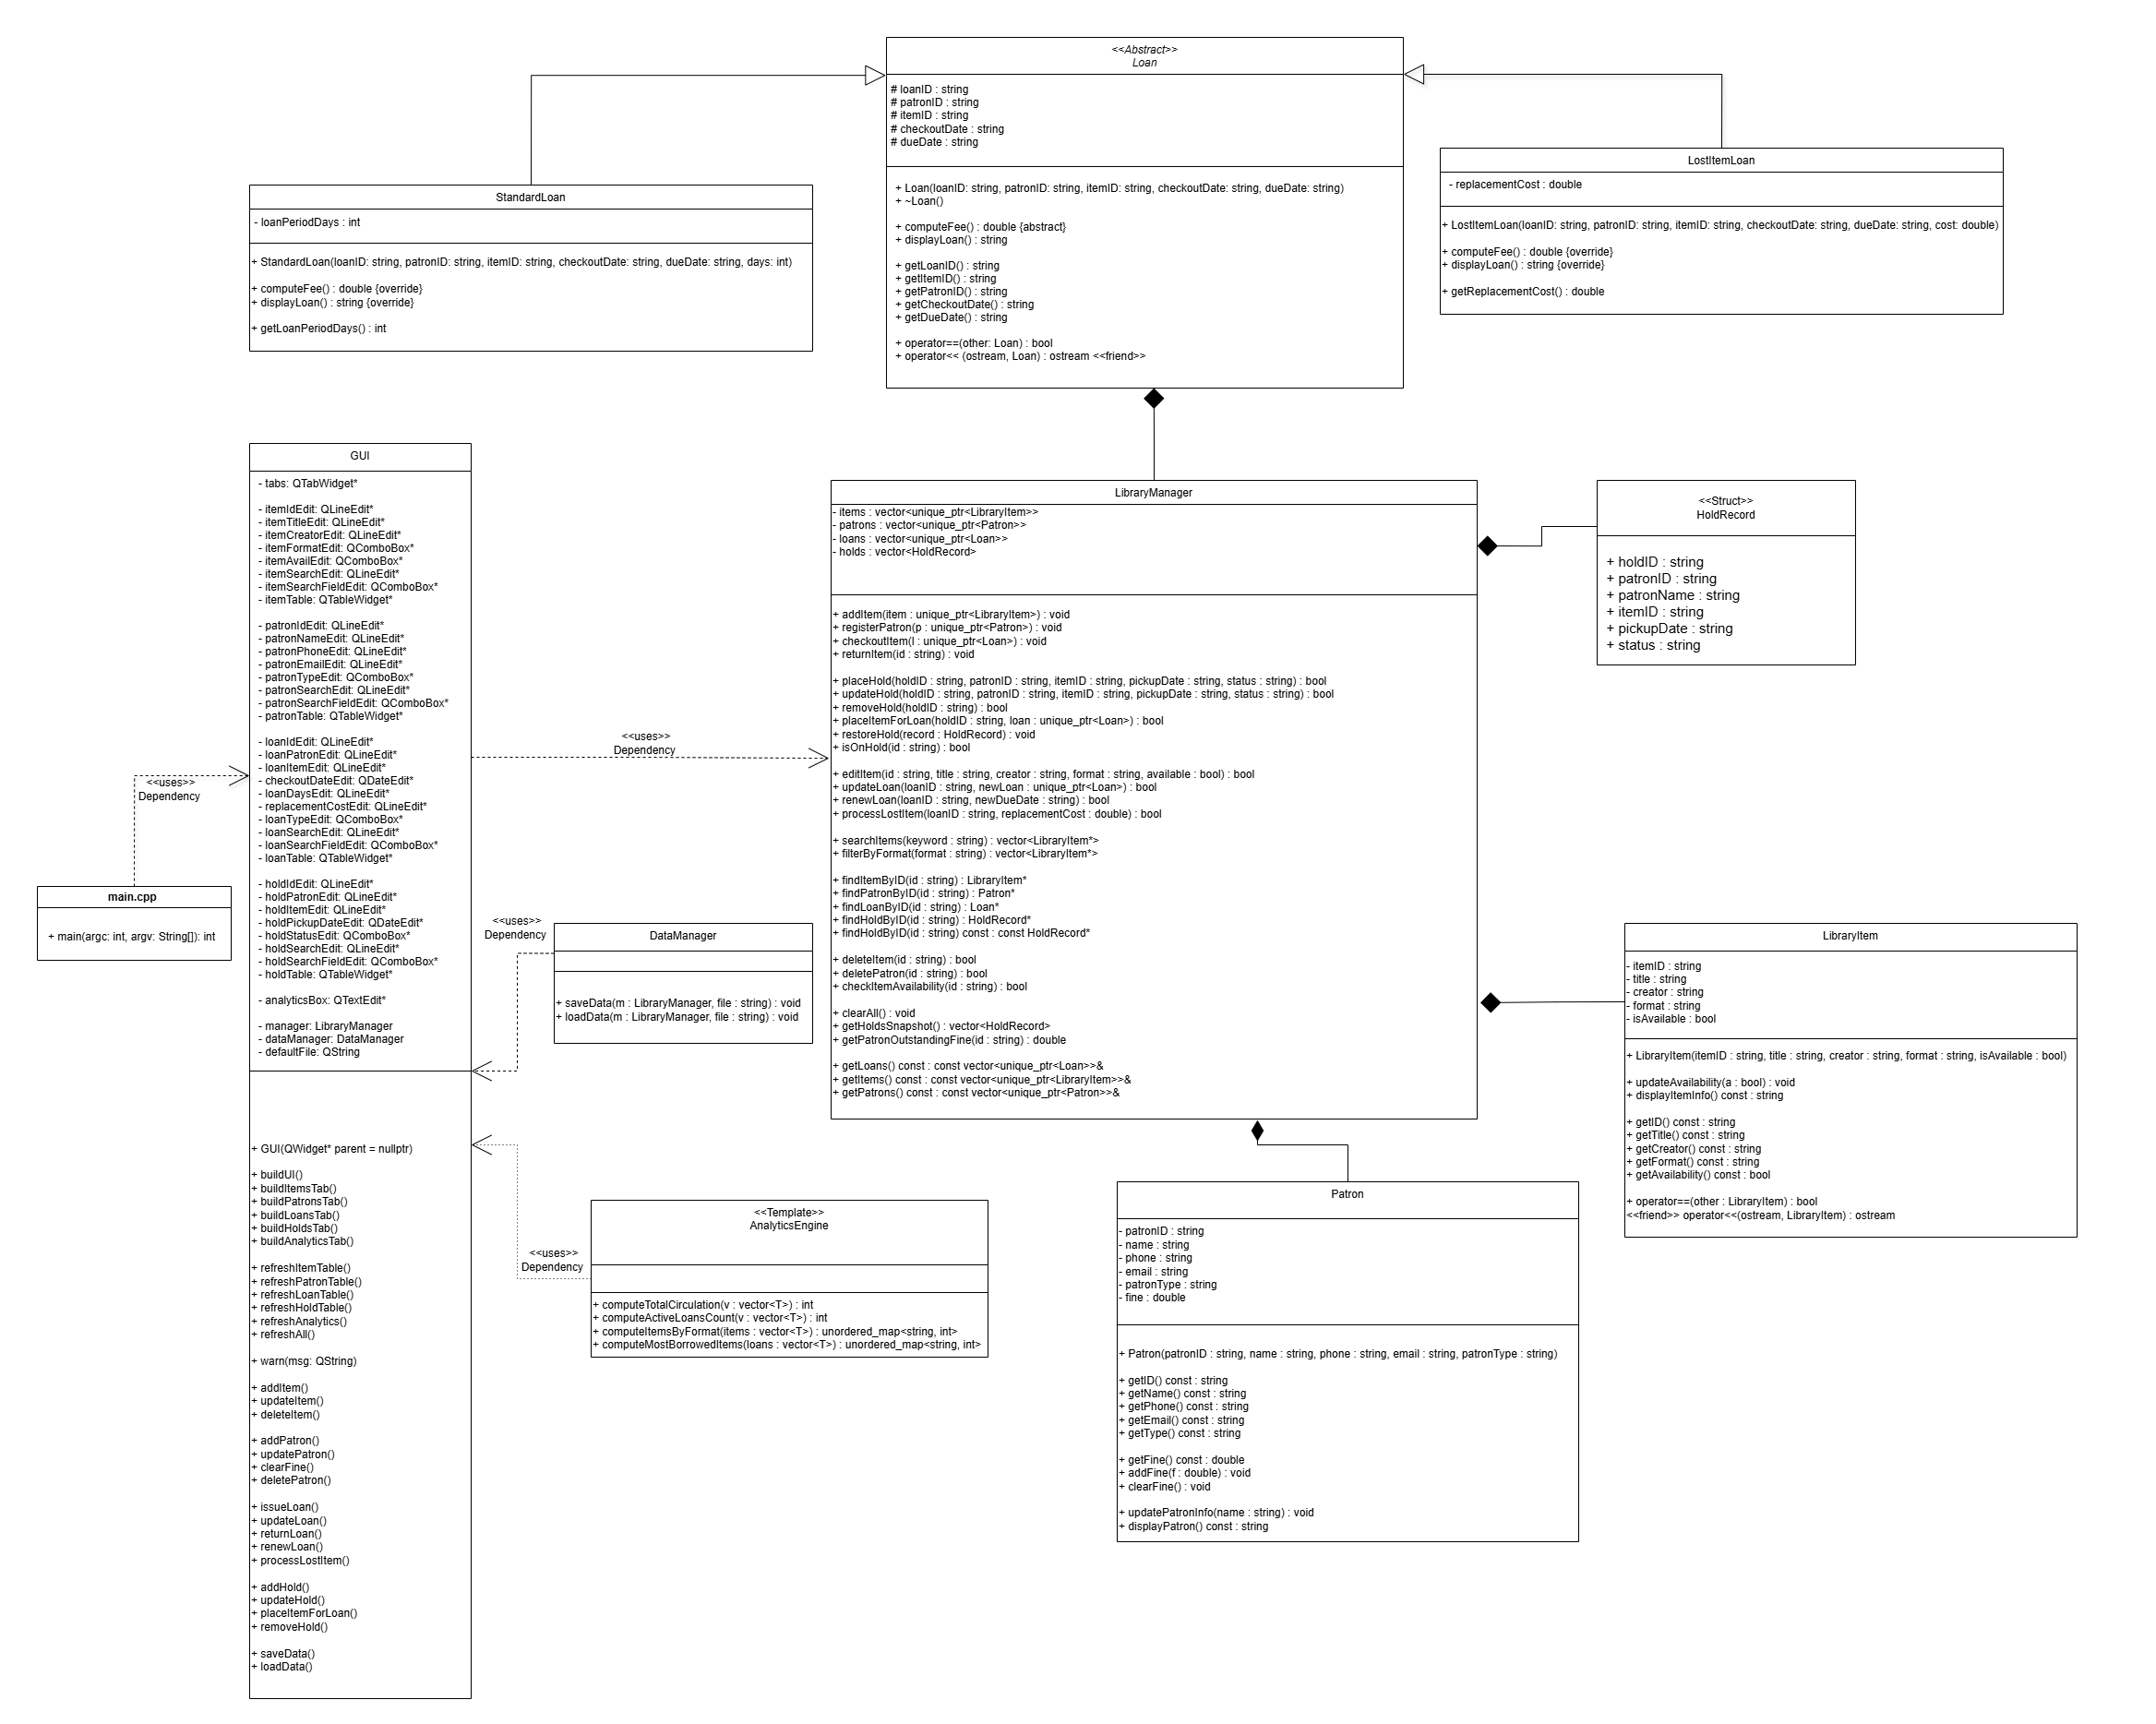

Slide 7

C++ Concepts
1) OOP:
Classes (LibraryItem, Patron)
Inheritance (Loan System)
Polymorphism
2) C++ Features:
Operator overloading (<<, ==)
Friend function
Smart pointers (LibraryManager)
3) STL:
Vector

Slide 8
Library Manager
Handles:
Adding / deleting items
Registering patrons
Checkout / return
Renew & hold system

Slide 9
LibraryManager Class Key Points
struct HoldRecord {
std::string holdID;
std::string patronID;
std::string patronName;
std::string itemID;
std::string pickupDate;
std::string status;
};
std::vector<std::unique_ptr<LibraryItem>> items;
std::vector<std::unique_ptr<Patron>> patrons;
std::vector<std::unique_ptr<Loan>> loans;

Slide 10

Other Concepts Used in Library Manager
dynamic_cast – Enables safe
downcasting
Namespace - Used for helper
Functions
std::remove_if (STL) - Used for
deleting items/patrons efficiently

Slide 11
User Data and Library Data
LibraryItem & Patron classes
Class design and structure
LibraryItem and Patron classes store essential data and include validation and operator overloading.

Slide 12
LibraryItem Class
Attributes: itemID, title, creator, format, availability
Functions: constructor, getters, updateAvailability(), displayItemInfo()
Operators: == and <<
Friend Function

Slide 13
Patron Class
Attributes: ID, name, phone, email, type, fine
Functions: constructor, getters, updatePatronInfo(), displayPatron(), addFine(), clearFine()

Slide 14
Concepts Used in LibraryItem and Patron
Constructor, Encapsulation
Operator overloading (==, <<)
Friend function
bool operator==(const LibraryItem&) const;
friend std::ostream& operator<<(std::ostream&, const LibraryItem&);

Slide 15

Loan Management
The Loan module manages borrowing transactions between patrons and library items.
It supports:
  checkout
  return
  renewal
  lost-item processing
  fee calculation
It ensures policy-based behaviour and prevents invalid operations.
This module connects GUI actions to business rules through LibraryManager.

Slide 16
Class Design for Loan Subsystem
Abstract Base Class: Loan
  Attributes:
    loanID, patronID, itemID, checkoutDate, dueDate (string)
  Methods:
    computeFee() = 0 (pure virtual)
    displayLoan()
Derived Classes:
  StandardLoan: Loan
    loanPeriodDays: int
    fee based on overdue days
  LostItemLoan: Loan
    replacementCost: double
    fee = replacement cost

Slide 17
C++ Concepts Used in Loan System
Abstraction + Inheritance + Polymorphism
Constructor chaining (Derived(...) : Loan(...))
Virtual destructor for safe polymorphic deletion
Smart pointers: vector<unique_ptr<Loan>>

Slide 18
Data Manager(JSON)
Data stored in JSON file (library.json)
Structured into items, patrons, loans, holds
Validates data before adding
Skips invalid or corrupted records

Slide 19
Input Validation
Uses Regular Expressions (Regex)
ID → 2 letters + 4 digits
Name → letters and spaces only
Phone → exactly 10 digits
Email → must end with @gmail.com
Ensures accurate and clean data

Slide 20

GUI Validation
User cannot type wrong input
Extra characters are blocked
Example: cannot type more than allowed

Slide 21
Error Handling
Detects duplicate IDs
Checks missing or invalid input
Displays warning messages

Slide 22
Boundary Handling
Input length strictly controlled
No extra characters allowed
Default values used when needed
Loan days → default = 7
Renew date → default = 2
Prevents invalid numeric values
Handles edge cases safely

Slide 23
GUI
Qt interface
Tabs and forms
User interaction

Slide 24
GUI Overview & Key Features System Architecture
Items: Collection management with search & validation
Patrons: Member management with fine tracking (CAD $)
Loans: Issue/update/return with fine enforcement
Holds: Reservation system with hold-to-loan workflow
Analytics: Real-time statistics & most borrowed items

Slide 25
Button Actions Summary
Tab | Action | What It Does
Items | Search | Filter items by selected field
Items | Add/Update/Delete | Manage library collection
Patrons | Clear Fine | Reset patron fine to $0.00
Loans | Issue | Create new loan (checks fine & availability)
Loans | Update | Modify existing loan details
Loans | Return | Mark item available, remove loan
Loans | Renew | Extend due date by 2 days
Holds | Add Hold | Queue item for patron (unavailable items only)
Holds | Place Item For Loan | Convert hold to active loan
Holds | Remove Selected | Cancel hold reservation

Slide 26
Challenges & Solutions
1. Integrating a Large Qt GUI With Backend Logic
Challenge:
Connecting dozens of UI widgets (QLineEdit, QComboBox, QTableWidget) with backend operations without breaking consistency.
Ensuring every tab (Items, Patrons, Loans, Holds, Analytics) updates correctly after each operation.
Solution:
Implemented a centralized refreshAll() method to update all tables and analytics in one call.
Used Qt’s signal–slot mechanism to bind buttons directly to backend functions (e.g., addItem(), issueLoan()).
Ensured clean separation of UI and logic by keeping all data operations inside manager.

Slide 27
Challenges & Solutions
2. Input Validation & Error Handling
Challenge:
Preventing invalid IDs, names, emails, phone numbers, and CAD amounts from entering the system.
Ensuring the GUI warns users without crashing.
Solution:
Added QRegularExpressionValidator for all critical fields (ID, name, Gmail, phone).
Created a reusable warn() function to display consistent error messages.
Added defensive checks before every operation (e.g., empty title, duplicate IDs, invalid creator name).

Slide 28
Conclusion
• Successfully built library system
• Applied C++ concepts
• Team collaboration

Slide 29

Thank You!
Questions or Feedback?
Team: Kavya, Chaitanya, Harpreet, Nibir, Vasu

